Slide 1
R Programming
Control Structures

Slide 2
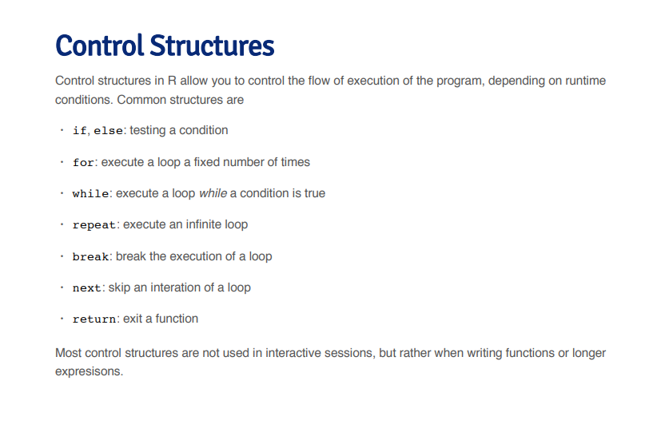
Switch case: testing multiple conditions

Slide 3
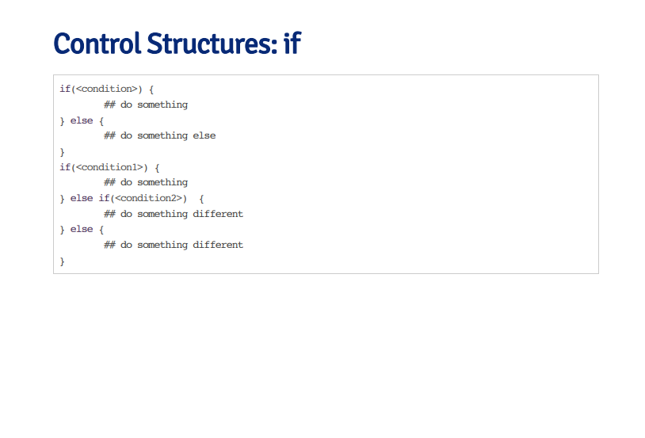

Slide 4
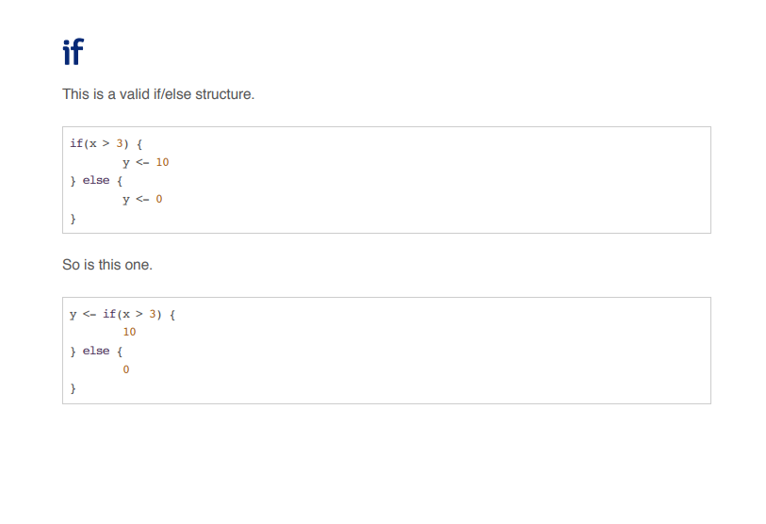

Slide 5
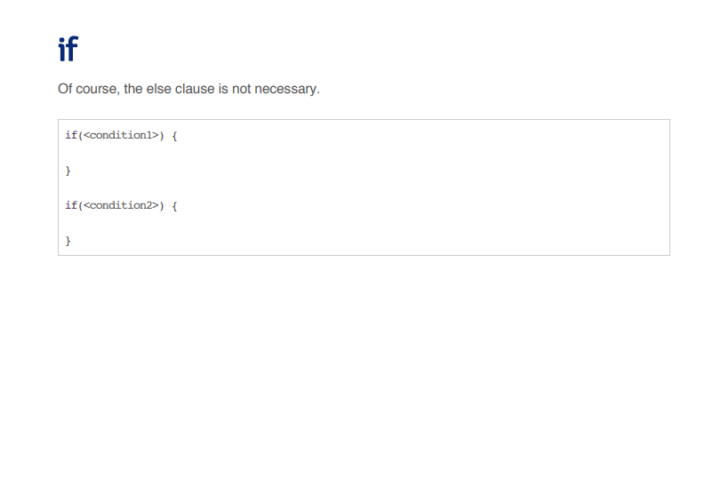

Slide 6
Switch Case
switch (expression, case1, case2, …, default)
# example:
x <- 3
switch (x,
"case1" = {print("The value of x is 1")},
"case2" = {print("The value of x is 2")},
"case3" = {print("The value of x is 3")},
"default" = {print("The value of x is not 1, 2, or 3")})

Slide 7
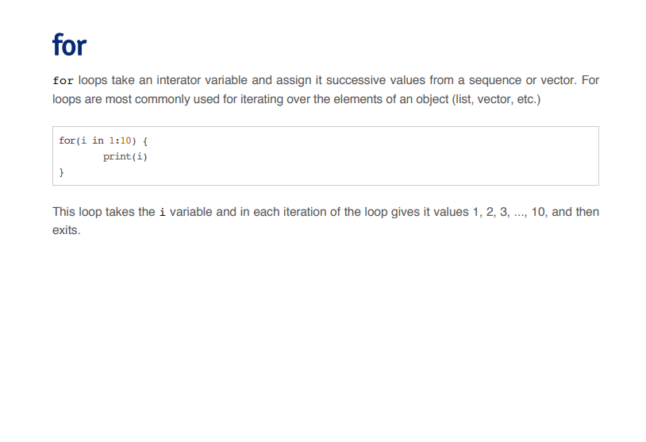

Slide 8
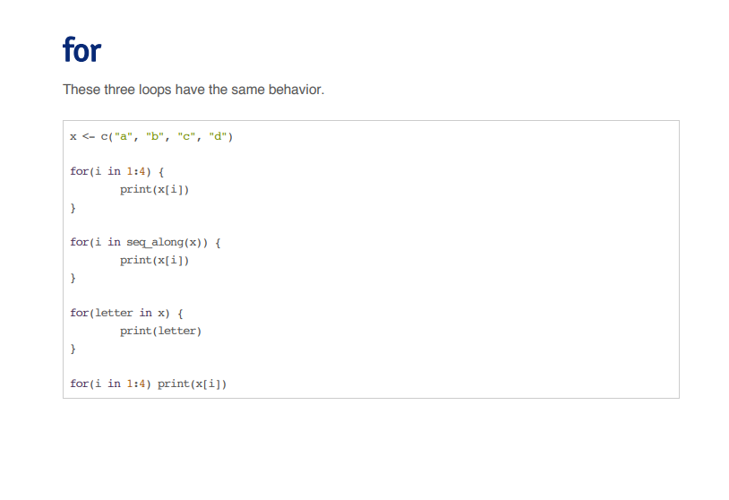

Slide 9
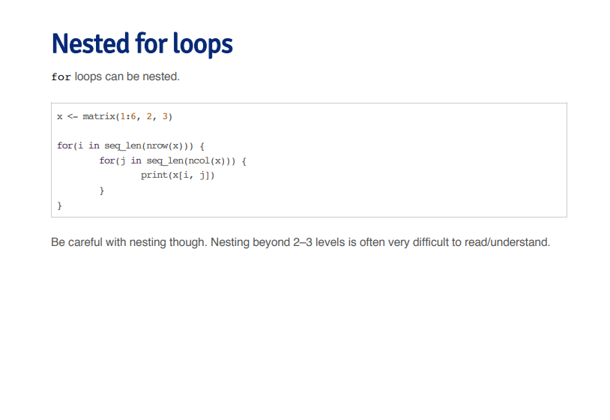

Slide 10
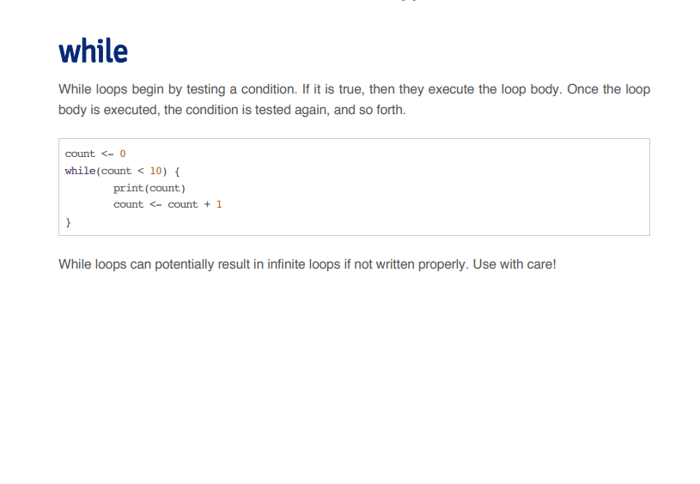

Slide 11
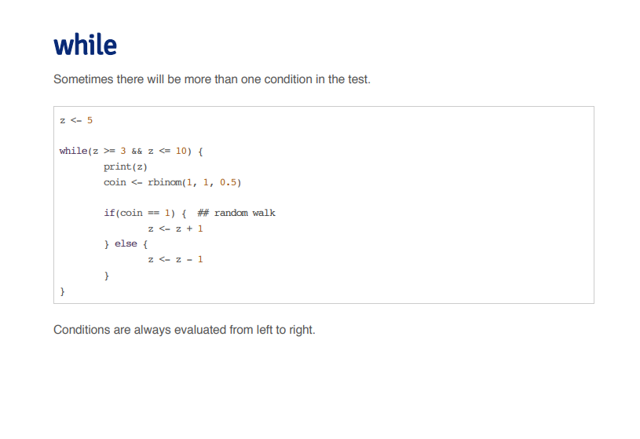

Slide 12
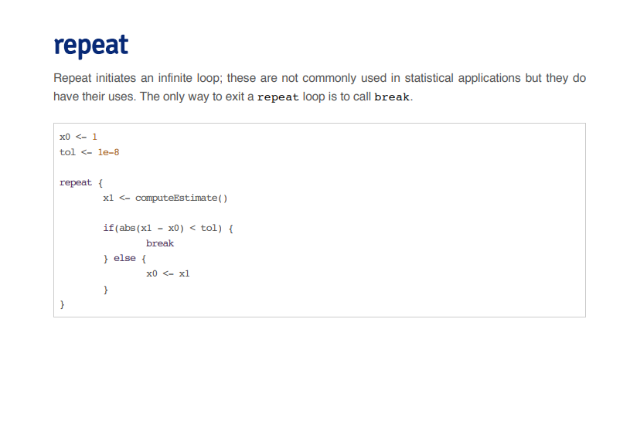

Slide 13
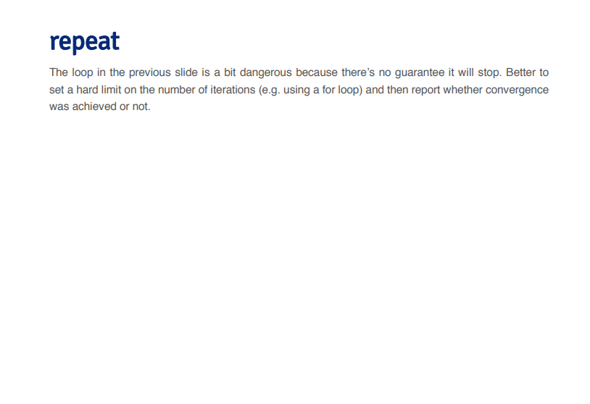

Slide 14
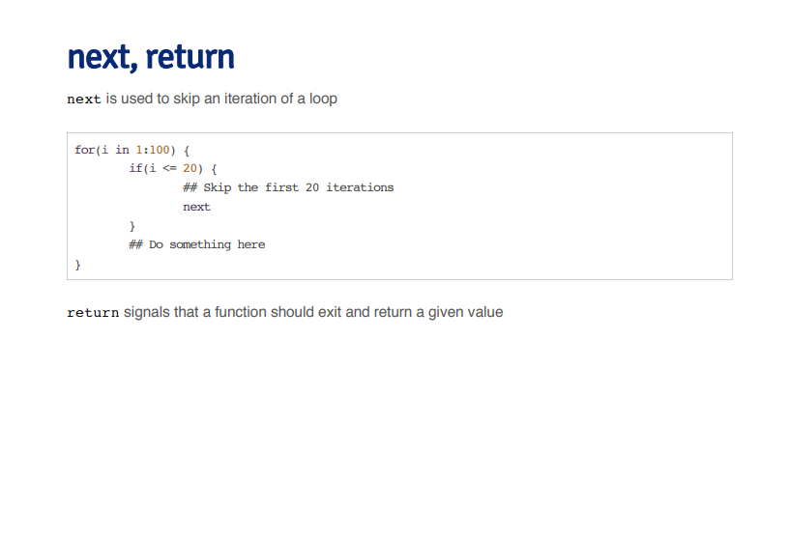

Slide 15
